Slide 1
Identify potential hazardous asteroids Team 10 – MIE1628
Johnson Zhao
Yangzhen Hu
Mengqiao Zhang
Celine (Pei Yao) Li
Jinhan Lin
Dec 10，2020
Notes:
NOTE : THIS PPT CONTAINS ANIMATION, PLEASE PLAY THE SLIDES TO SEE WHAT EACH SLIDES ACTUALLY LOOK LIKE
Motivation of the project: In modern-day society, research and commercialization around self-driving cars and navigational GPS apps are on the rise. Image recognition is an essential component of self-driving cars. For example, if self-driving cars can recognize housing numbers from their cameras, then they would be able to verify whether they have arrived at the correct destination. Additionally, GPS maps could employ street view images to add new or missing addresses into their maps if it can effectively perform street view image recognition

Slide 2
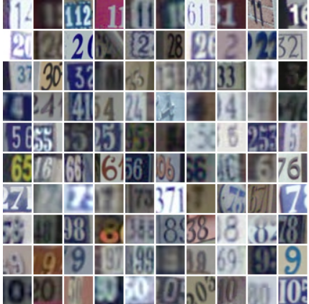
Problem Statement
Dataset:
Description: Various types and colours of housing numbers on various backgrounds
Original dataset: 73,257 images for training, 26,032 images for testing
Scope of this Project and Model Evaluation: used 2000 for training and 800 for testing from the original dataset
Objective:
Effectively recognize the most central digit that’s entirely present in each image (numbers partially present are noises)
Exploring the effectiveness of using Support Vector classification (SVC), Logistic Regression, K-nearest neighbours (KNN), Random Forest, Ensemble Stacking, and Convolution Neural Networks (CNN), for number recognition in the images
Dataset source: http://ufldl.stanford.edu/housenumbers/
Notes:
The input dataset are images like shown on left, there’s various types and colours of housing numbers on various backgrounds
The original dataset is very large with over 73 thousand images for training, so for the purpose of this project, in order to mitigate very long run time, I uniformly selected 2000 image for training and 800 for testing from the whole dataset
Objective of the model is to effectively recognize the most centralized digit that’s entirely present in each image. This is not trivial because there’s a lot of digits that are partially present which adds a lot of noise, the model needs to learn to ignore these partial digits and other background noise when classifying, which can be challenging.
In order to achieve this, various supervised learning algorithms were explored.

Slide 3
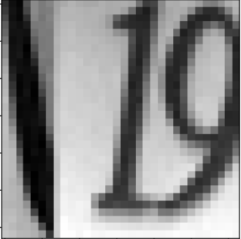
Data Preprocessing and Feature Engineering
The format of the dataset is 32-by-32 pixel coloured images
Each pixel indicates the intensities of 3 colors (red, green, blue)
Thus, (32 pixel x 32 pixel x 3 colours ) = 3072 features per sample data
Images were first converted from colour (RGB) to greyscale
Reduced number of feature to (32 x 32 x 1 ) = 1024 features per sample
Clarity of the image not really affected
The original pixel values are from 0 to 255
Linearly normalized each pixel value to be in the range of 0 to 1
Three Jupiter notebooks were created: first for non-neural& ensemble methods, second is CNN with 2000 samples, lastly CNN with all samples
To make fair comparisons between the model performances, the same data preprocessing was used at the beginning for all models.
Notes:
So the input features to these algorithms are the images’ pixel values
In order to reduce the large number of features, the inputs were first converted from colour to greyscale, this didn’t really impact the clarity of the images either
The input pixel values all range from 0-255, so they were normalized to achieve better optimization.
Although different models were created, to make a fair comparisons between their performance, the same data preprocessing was done for all of them

Slide 4

Non- neural Models Performance
Best
3rd
Random Forest (RF)
Without PCA:
initial 27% accuracy, 48% accuracy after hyperparameter tuning via random search
With PCA:
50% accuracy with hyperparameter tuning - best individual non-NN model
K-Nearest Neighbors (KNN)
Without PCA:
initial 27% accuracy, 28% accuracy after hyperparameter tuning via random search
With PCA:
30% test accuracy after hyperparameter tuning
Logistic Regression
With PCA :
Only 18% test accuracy –very poor
Not included in ensemble
Support Vector (SVC)
With PCA and Kernel Trick:
32% test accuracy after hyperparameter tuning via grid search
Accuracy increased to 68% after using all 73,257 training sample instead of 2,000 samples
2nd
Ensemble of the top 3 model performed worse than RF model alone
- Ensemble 38% test accuracy vs RF 50% test accuracy
Ensemble of top 2 model (RF & SVC) still performed worse than RF alone - 42% accuracy
Notes:
Here are the 4 non-neural models explored, and the best model is random forest with PCA. AND SVC and KNN with PCA are ranked 2nd and 3rd.
PCA is an unsupervised learning method to further reduce the input feature numbers and avoid overfitting. As we can see, the models did perform slightly better after using PCA.
Hyper-parameter tuning is very important as well, for example……..
Although 50% is not bad, but it’s not A satisfactory performance, so I tried ensemble of these models to see if it can perform better.

Slide 5
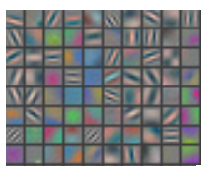
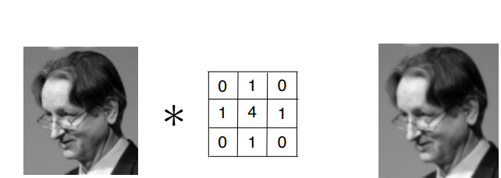
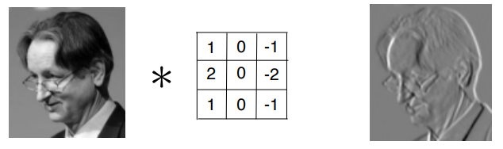
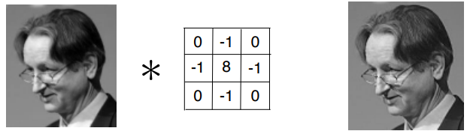
Convolutional Neural Network (CNN)
ConvNet is known for its outstanding performance in image classification
In 2012, 2 students from Uof T along with their professor, Geoffrey Hinton, published a paper on CovNet due to its winning performance in ImageNet classification contest
ConvNet (CNN) applied filters across the whole image to assign importance to various patterns and features in the image in order to differentiate one from another.
Good at pattern and feature recognition
Notes:
Motivation of Why I chose convet above all neural network model:
In a nutshell: CNN method is a deep learning algorithm that can take an input image and applied filter across the image to assign importance to various aspects in the image in order to differentiate one from another. The benefit of the CNN method is that is efficient in recognizing patterns and key features in images

Slide 6
ConvNet Model Performance
ConvNet in general are prone to overfitting, and require a large amount of training data
CNN with 2000 training samples achieved 75% testing accuracy
a significant increase from 50% accuracy with 2000 samples using RF
CNN with the entire 73,275 training samples achieved 92% testing accuracy
a significant increase from 68% accuracy with 73,275 samples using RF
Performed lots of hypermeter tuning in order to achieve the 92% high testing accuracy
Tried various activation functions
Tried various depths of each CNN layer
Tried various number of neurons of the dense layer
Tried various epoch size for training
Tried various drop out rate to reduce overfitting
Notes:
The challenges with applying the CNN method are potential overfitting, and also it requires a large amount of training data in order to perform well.

Slide 7
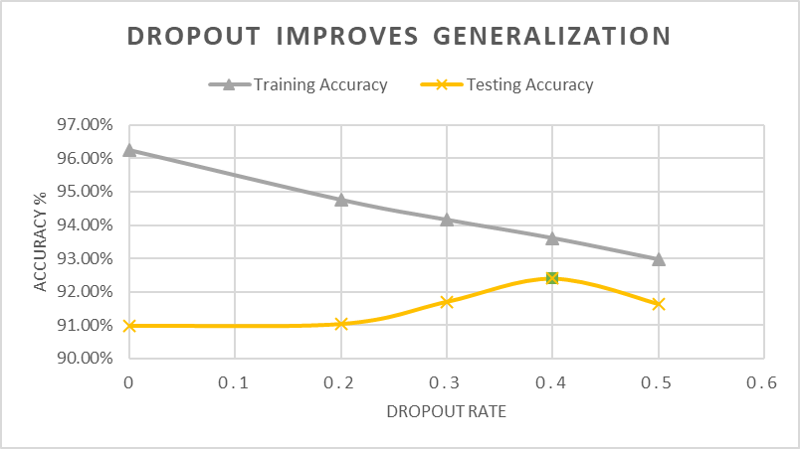
Example of a CNN Hyperparameter Tuning: using dropout to reduce overfitting
Dropout Rate | Training Accuracy | Testing Accuracy
None | 96.24% | 90.97%
0.2 | 94.75% | 91.03%
0.3 | 94.15% | 91.70%
0.4 | 93.60% | 92.40%
0.5 | 92.96% | 91.63%
*Dropout means deactivating or ignoring a percentage of the neurons during training to reduce overfitting
Notes:
Drop out in a nutshell means deactivating or ignoring a percentage of the neurons during training
Default model without drop out had a big gap between training accuracy and test accuracy- indicator the model is overfitting
As the dropout rate increased, the model was able to generalize better, so by using dropout the Convnet model avoided overfitting and performed very well..

Slide 8
Final Model Comparisons
Model | Test Accuracy
Logistic Regression | 17%
K-Nearest Neighbours | 30%
Support Vector Classifier | 32%
Random Forest (2,000 vs 73,257 training samples) | 50% vs 68%
Ensemble of KNN, SVC and RF | 38%
Ensemble of SVC and RF | 42%
ConvNet (2,000 vs 73,257 training samples) | 75% vs 92%
Final Proposed Model : ConvNet with 92% testing accuracy
Notes:
Here’s a comparison on the performance of all the different methods explored, Random Forest and Convnet trained with larger dataset significantly out performed other models.
Thus, it is chosen as they are chosen as the final proposed model for this project.

Slide 9
Confusion Matrix Evaluation
ConvNet (2000 samples)
Lots of 5 and 6 misclassified as 8
Lots of 5 and 9 misclassified as 3
0 misclassified as 9
ConvNet (73,257 samples) results below are scaled proportionally to match the number of total of test images on the left
Very few misclassification:
A few 1 misclassified as 4 and 7
A few 3 misclassed as 2 and 5
A few 6 misclassed as 8
Random Forest (2000 samples)
4 misclassified as 6 and 9
7 misclassified as 2
9 misclassified as 5, 8 and 0
Random Forest (73,257 samples)
Overall less misclassification
Lots of values misclassified as 1
2 misclassified as 7
Notes:
This confirms, that model is not making random weird predictions, even the errors are understandable. This information can be used to further improve the model, because we could include more samples for the digits that are prone to be misclassified

Slide 10
Findings
Performing hyperparameter tuning can significantly increase the model performance and reduce overfitting
PCA is an effective method to reduce the large feature size and enable better model performance
Future Improvements
Employ bagging and boosting techniques to oversample the ones that will likely be to misclassified and boost weak classifiers
If computation power allows, perform more grid search on larger training set, and use images with higher resolution (e.g. 64x64)
Notes:
Hyperparameter tuning significantly increase the model performance and reduce overfitting
2) PCA is an effective method to reduce the large feature size and enable better model performance
As I mentioned in the confusion matrix slide, we can increase the type of images that are likely to be misclassified to further improve the models' performance.
All these can help further improve the model’s performance so it can be deployed in self-driving cars to help them navigate better

